Slide 1
Results for lPFC

Slide 2
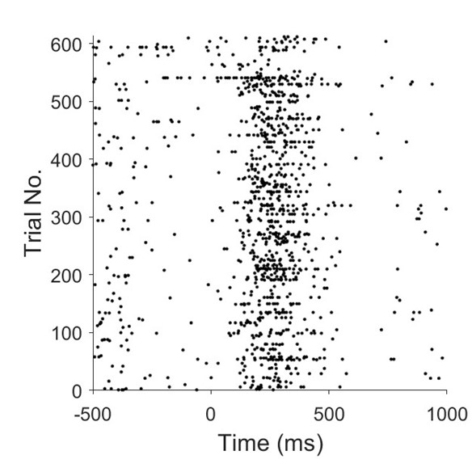
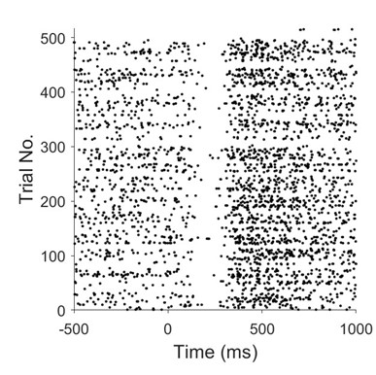
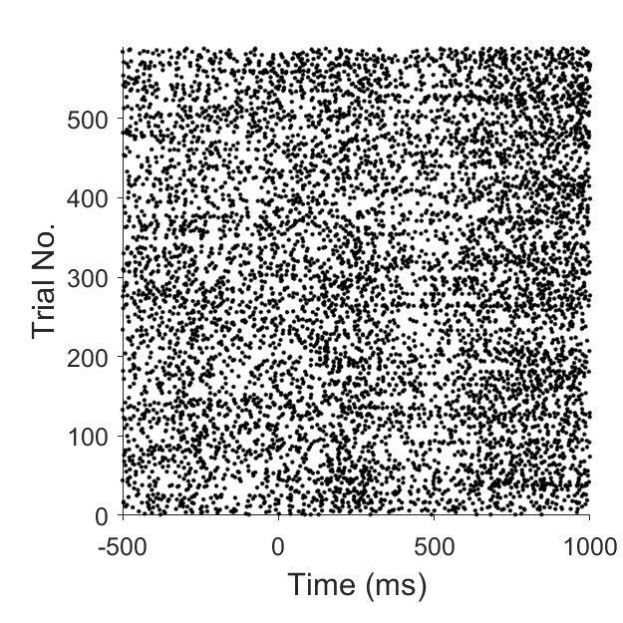
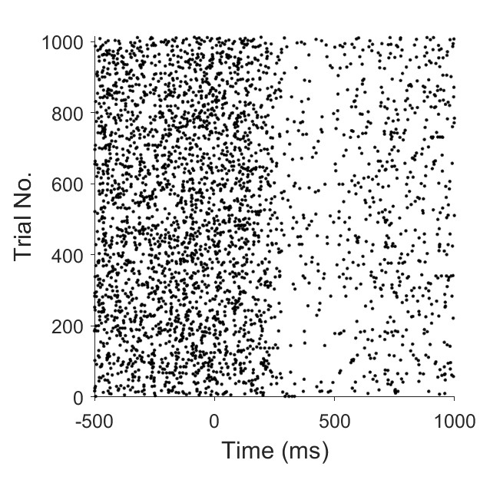
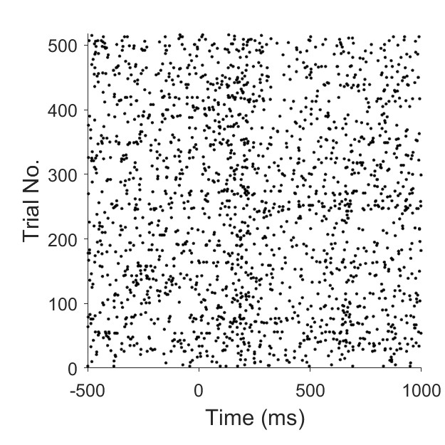
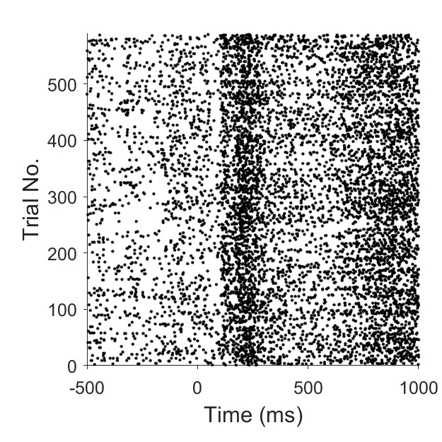
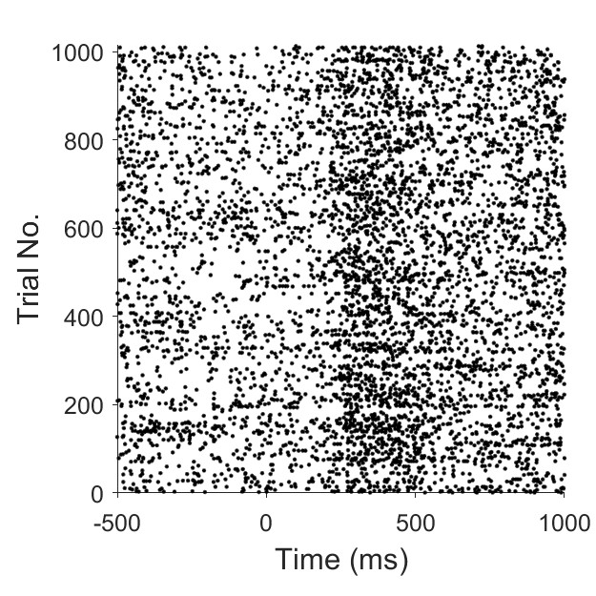
Replication of rasterplots
Fig. 4 replication
Fig. 5 replication

Slide 3
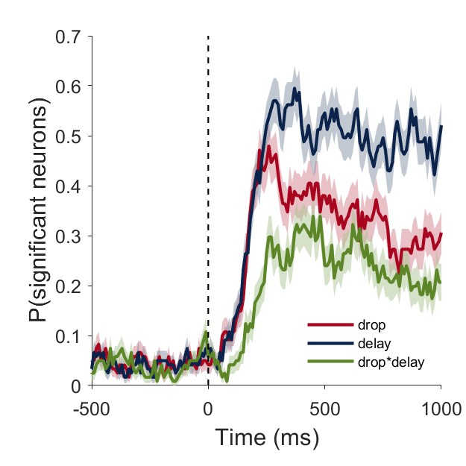
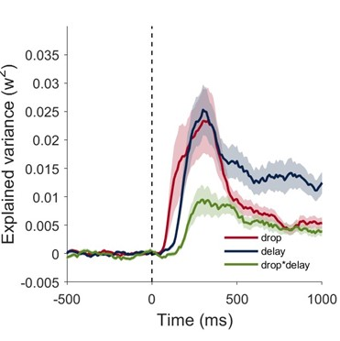
Replication of Fig.3
Effect-size plot

Slide 4
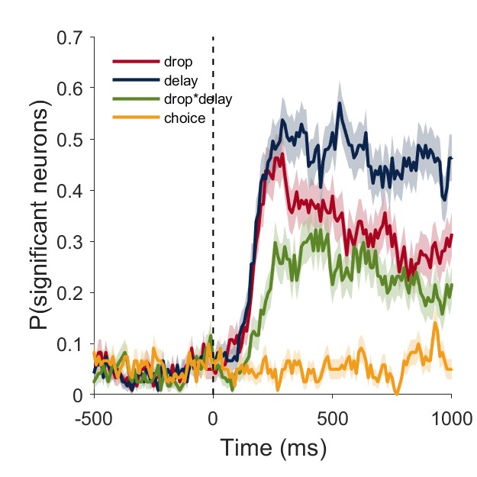
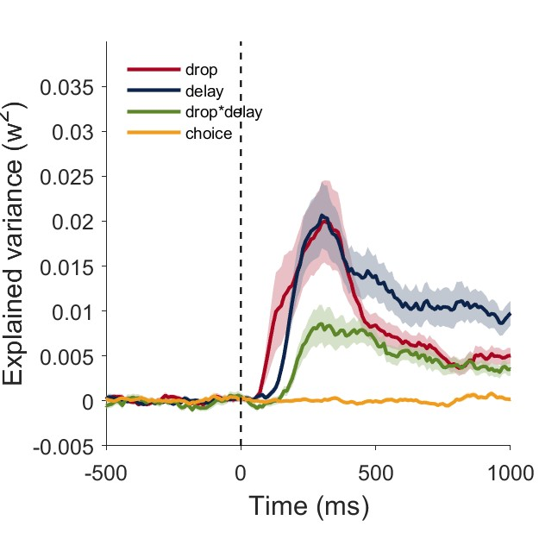
ANOVA + choice
Effect-size plot

Slide 5
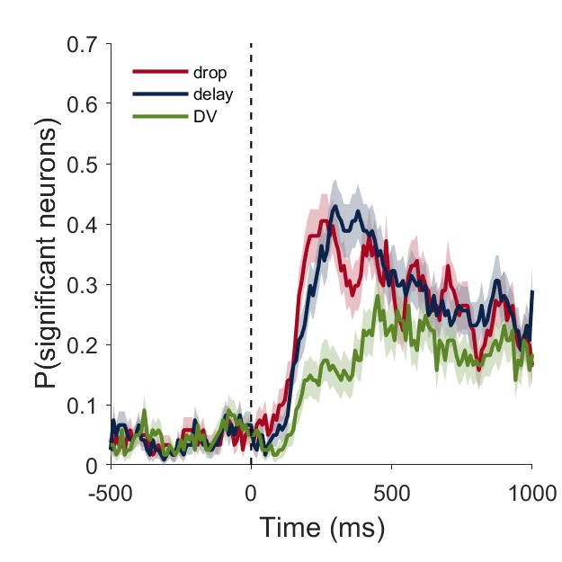
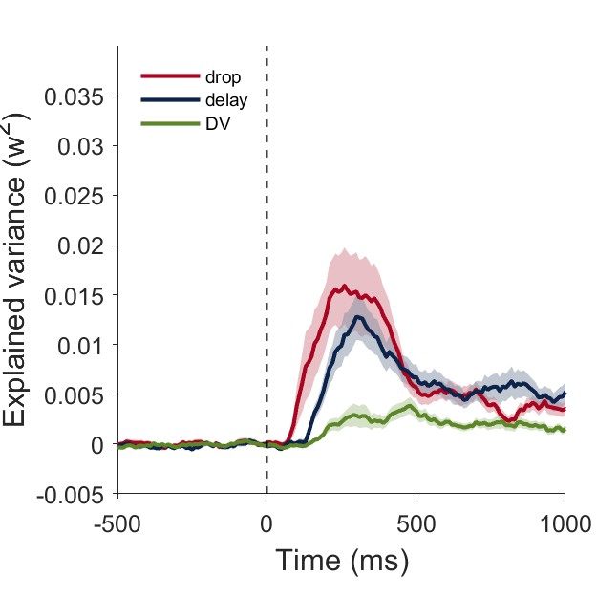
ANOVA: drop, delay, value(cont)
Effect-size plot

Slide 6
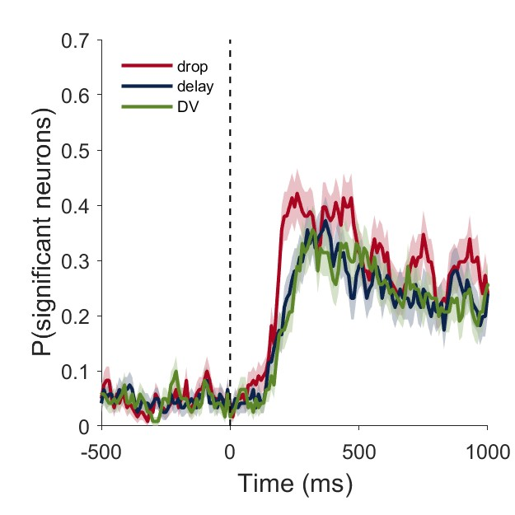
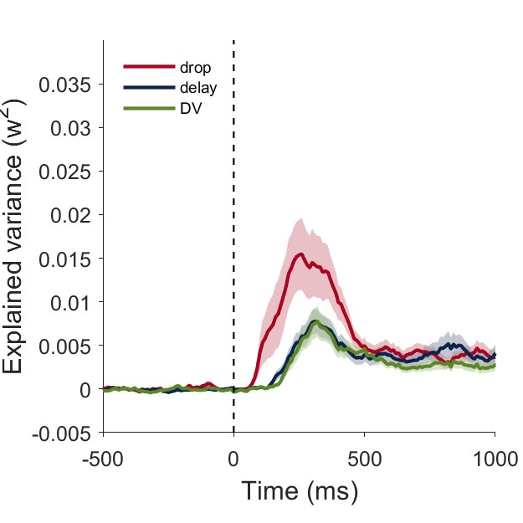
ANOVA: drop(cont), delay (cont), value(cont)
Effect-size plot

Slide 7
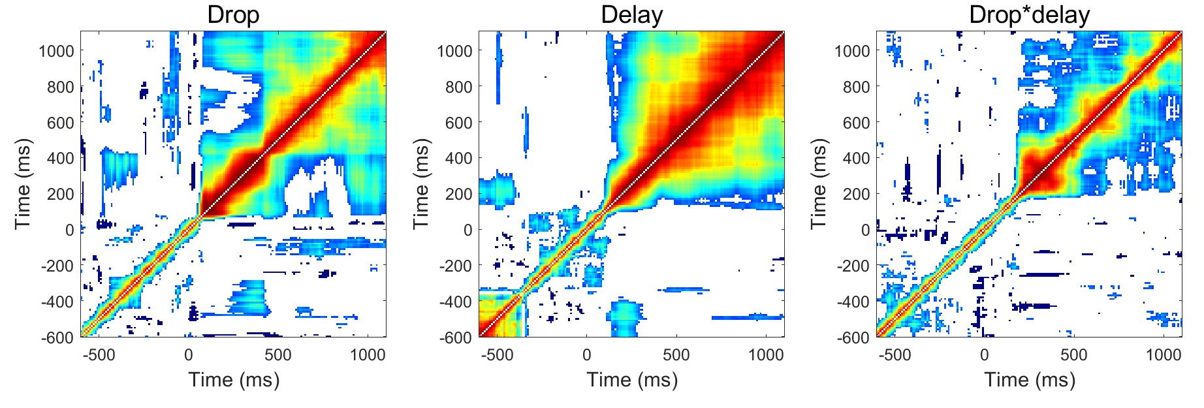
Sustained activity for drop, delay, and interaction (replication Fig. 6)

Slide 8
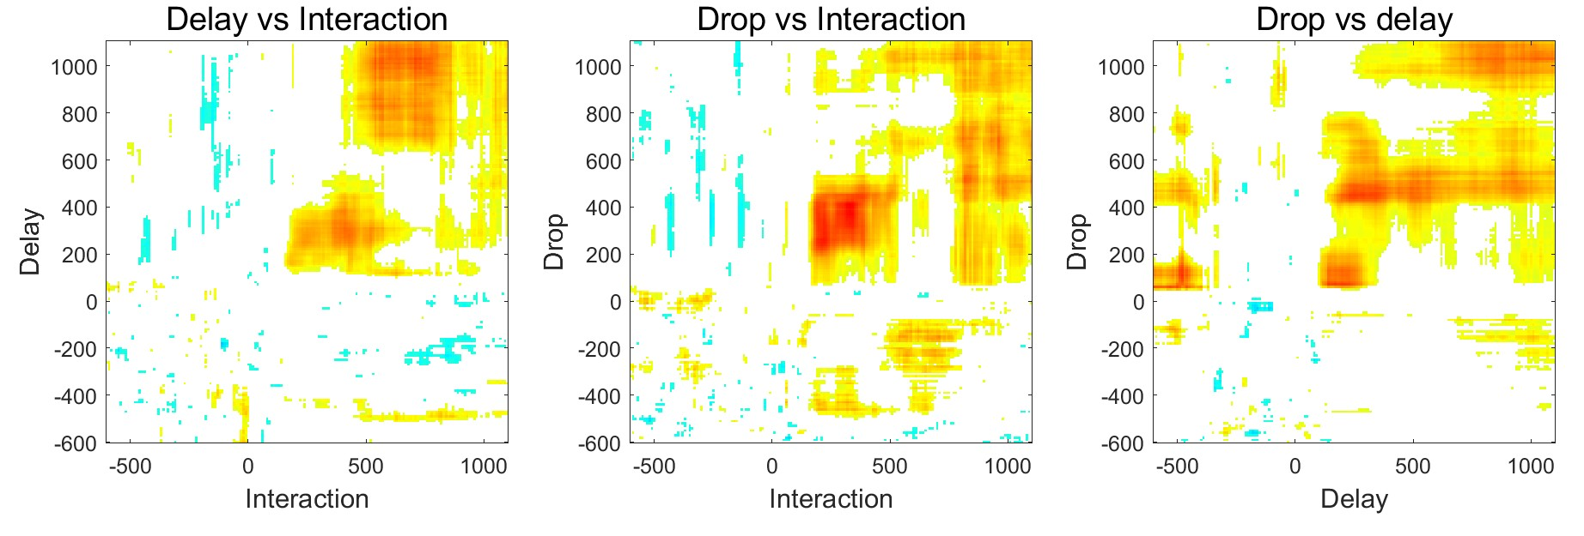
Sustained activity for drop, delay, and interaction (cross-correlation)

Slide 9
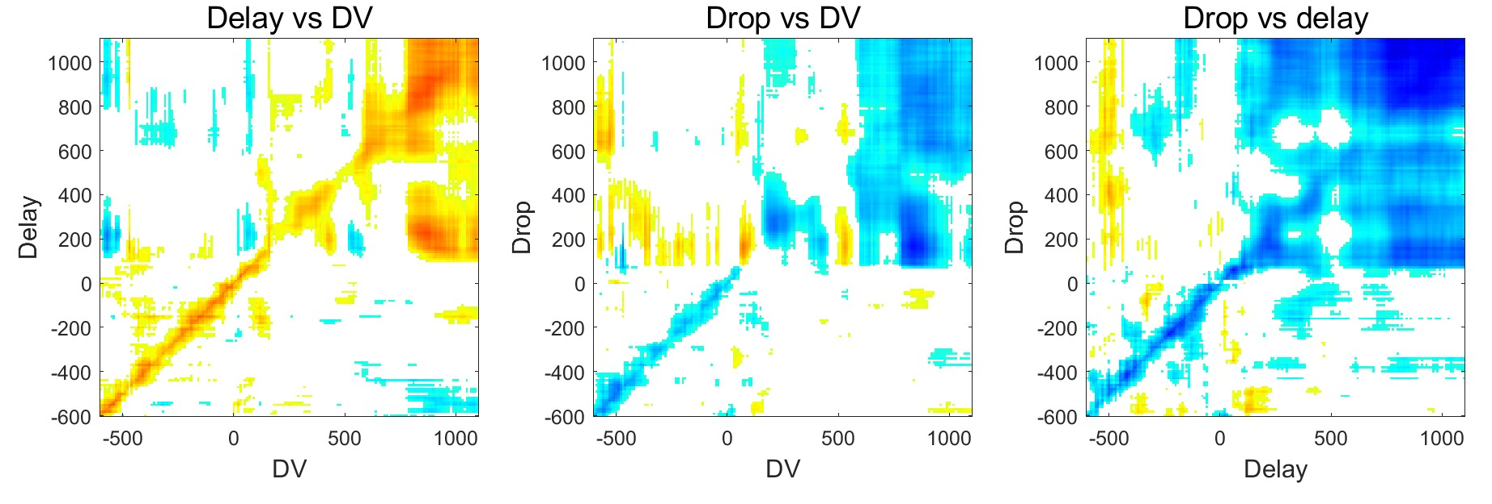
Sustained activity for drop, delay, and VALUE (cross-correlation)

Slide 10
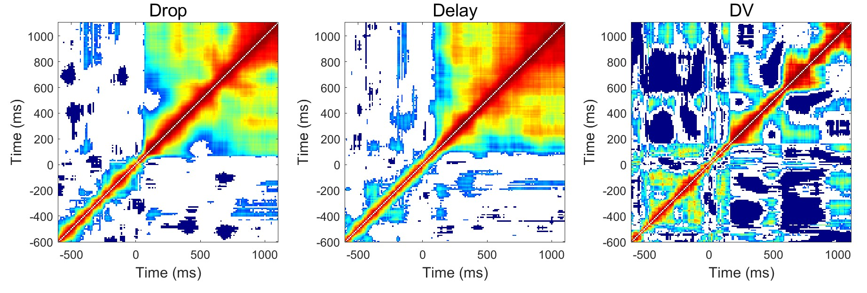
Sustained activity for drop, delay, and VALUE (auto-correlation)

Slide 11
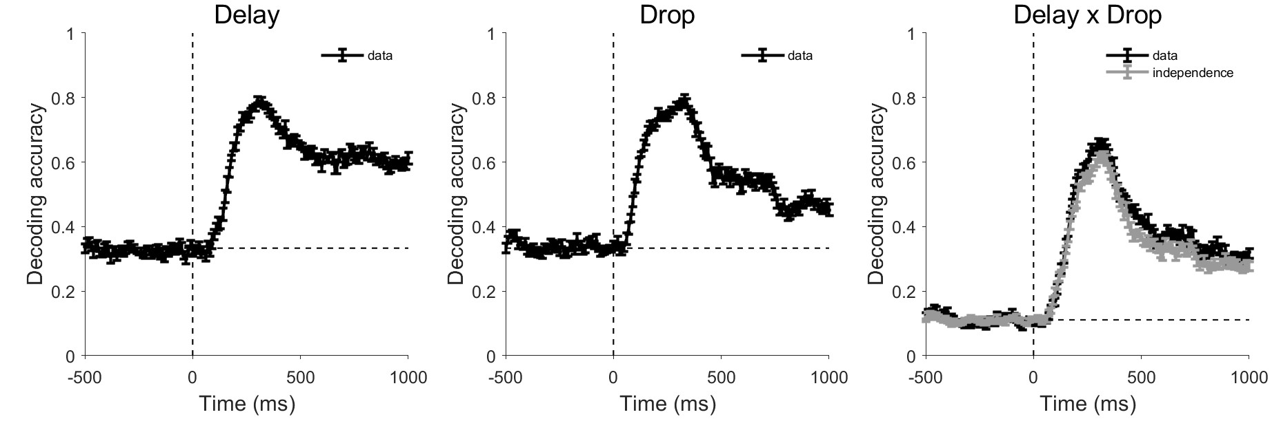
Decoding analysis

Slide 12
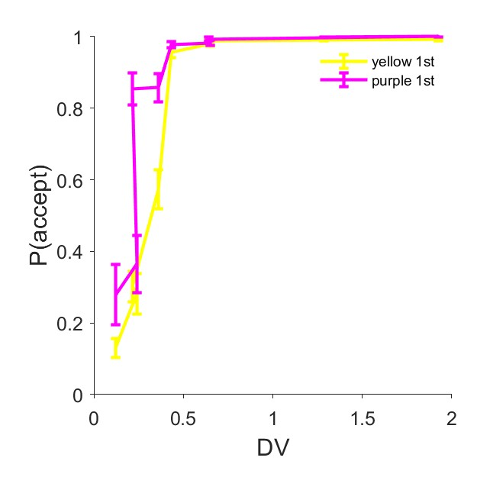
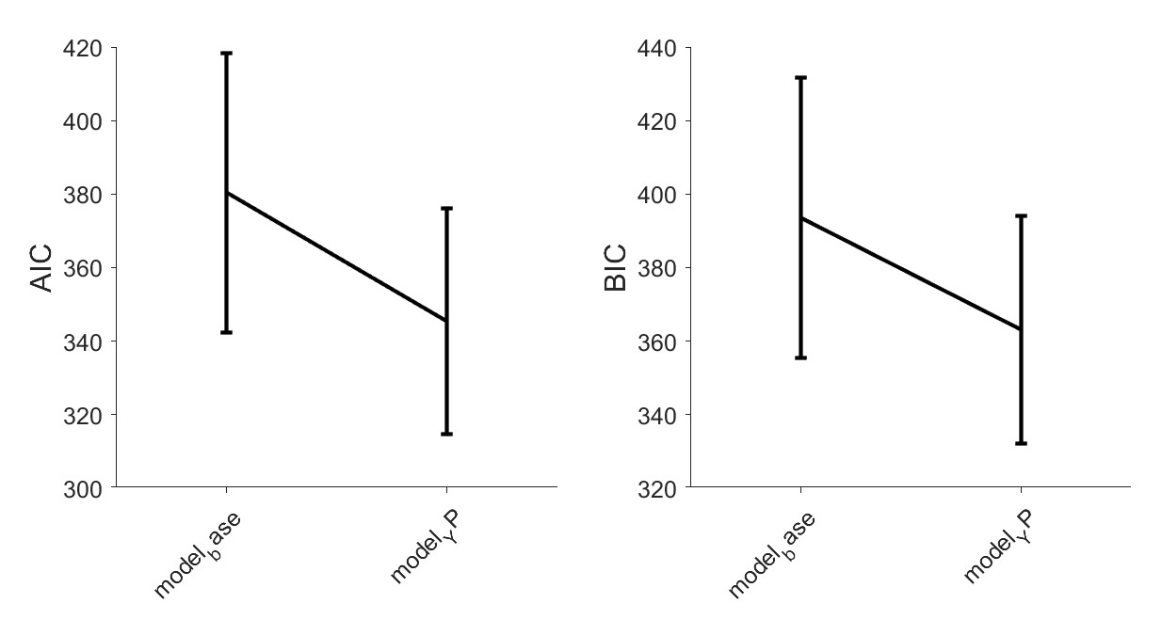
Yellow 1st vs Purple 1st

Slide 13
Not implemented
1. Purple and Yellow should shift “value coding” in the population analysis
2. A low dimensional dynamics analysis on the 3 features (drop, delay, value). This is best done with the Waldo/Voltaire dataset but can be done with vlPFC dataset.
3. ANOVA at the choice period can dissociate action from choice.
(this can be a separate paper)

